Slide 1
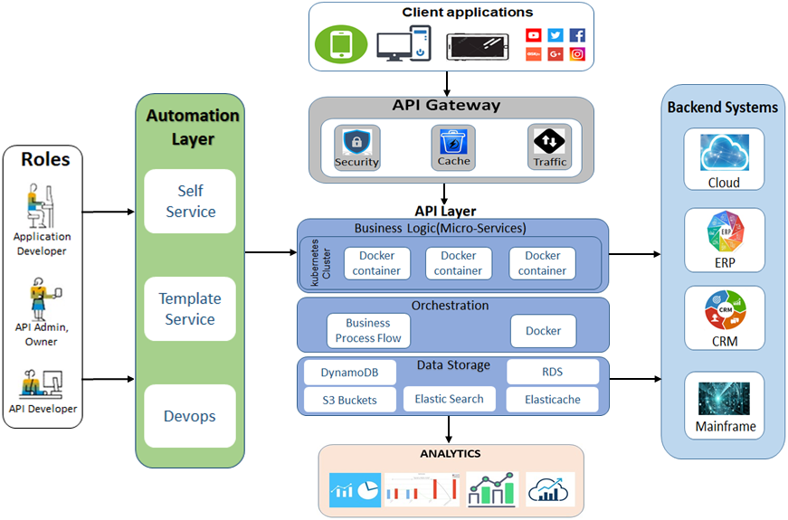

Slide 2








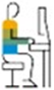
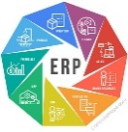
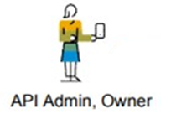
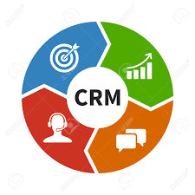
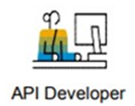


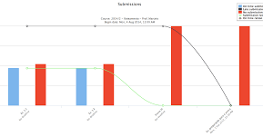


Client Applications
Backend
Systems
Automation Layer
API Gateway
Roles
Self Service
Security
Cache
Traffic
Cloud
Application Developer
API Layer
aaaaaaaaaaaaaaaaaaaaaaaaaaa
Business Logic(Micro-Services)
Template Service
ERP
kubernetes
Cluster
Docker container
Docker container
Docker container
API Admin, Owner
Orchestration
CRM
Devops
Business Process Flow
Docker
API Developer
DynamoDB
Data Storage
RDS
Elastic Search
Elasticache
Mainframe
S3Buckets
Analytics

